Slide 1
PageRank and Markov Chains lecture-6 Course on Graph Neural Networks (Winter Term 20/21)
Prof. Dr. Holger Giese (holger.giese@hpi.de)
Christian Medeiros Adriano (christian.adriano@hpi.de) - “Chris”
Sona Ghahremani (sona.ghahremani@hpi.de )

Slide 2
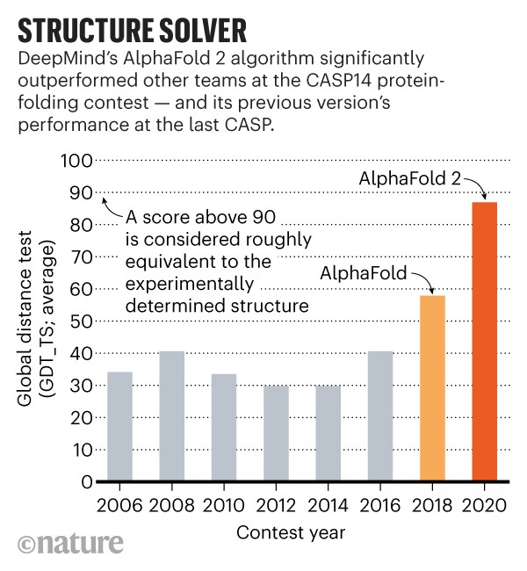
Breaking news on Learning on Networks
Goal: predict the protein’s constituent parts = a string of different amino acids and map out the many twists and folds of its eventual shape. Poor predictions in 1980s and 1990s.
AphaFold-1 (2018):
1- apply deep learning to structural and genetic data to predict the distance between pairs of amino acids in a protein
2- use this information to build ‘consensus’ model of how the protein should look like
[Nature 2020] It will change everything: DeepMind’s AI makes gigantic leap in solving protein structures - Google’s deep-learning for determining the 3D shapes of proteins https://www.nature.com/articles/d41586-020-03348-4
Can a Computer Devise a Theory of Everything?*
The Feynman Lectures on Physics -> used them to generate data that was then fed to a neural network. DL was able to recover all 100 formulas
Data from the Large Hadron Collider -> the system successfully identified and distinguished between quarks and gluons, without ever knowing what either was.
*It might be possible, physicists say, but not anytime soon. And there’s no guarantee that we humans will understand the result…
NY Times - https://www.nytimes.com/2020/11/23/science/artificial-intelligence-ai-physics-theory.html

Slide 3
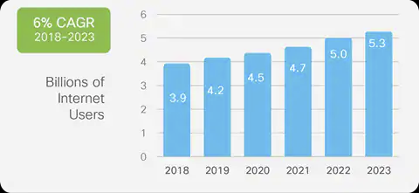
Motivation [Cisco Annual Internet report 2020]
Nearly 2/3 of the global population will have Internet access by 2023, i.e., 5.3 billion total Internet users (66% of global population) and up from 3.9 billion (51% of global population) in 2018.
2023:
29.3 billion networked devices (compared with 18.4 billion in 2018)
14.7 billion IoT connections (33% growth over 2-18)
Connected home apps will have the largest share and connected cars will be the fastest growing application type.
Connected home apps will have nearly half or 48% of IoT share by 2023 and Connected car applications will grow the fastest at 30% over the forecast period (2018–2023).
How to make predictions on networks of hundreds of billions of nodes which are constantly evolving?
We need to sample effectively = node ranking
This allows better search and more efficient monitoring
Google PageRank takes few weeks for the crawlers to map of the entire web and a few hours to recompute the importance of pages.
[Cisco 2020] Cisco Annual Internet report , https://www.cisco.com/c/en/us/solutions/collateral/executive-perspectives/annual-internet-report/white-paper-c11-741490.html

Slide 4
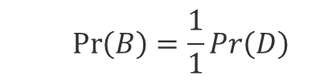
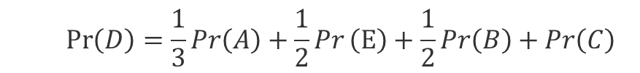
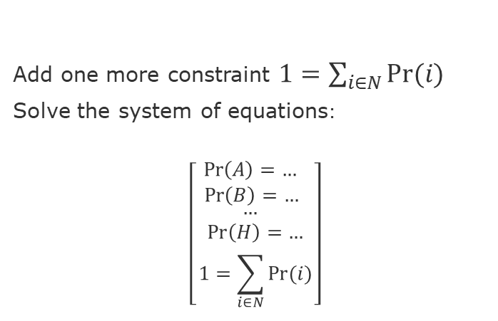
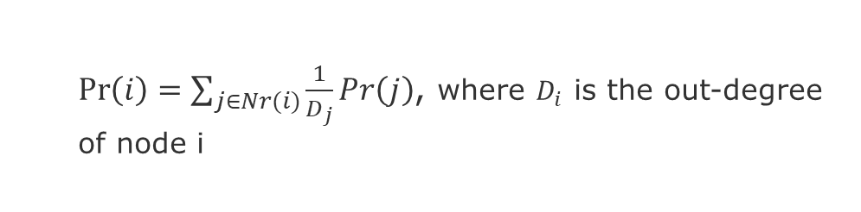
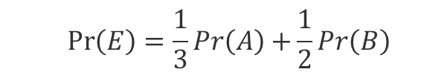
What we want
If I spend time randomly surfing the web, assuming equal time between clicks, what percent of time would I be on each page? i.e., how important is each node?
$$\operatorname{Pr}\left(E\right)=\frac{1}{3}Pr\left(A\right)+\frac{1}{2}Pr\left(B\right)$$
Importance of a node (Pr):
In-links are less prone to be manipulated
Importance is proportional to its neighbors
Flow/Message passing way to computing
Hub
E
F
A
H
B
Lose, dangling node
(dead-end)
G
$\operatorname{Pr}\left(i\right)=\sum_{j∈Nr(i)}{\frac{1}{D_{j}}Pr\left(j\right)}$, where $D_{i}$ is the out-degree of node i
C
D
$$\operatorname{Pr}\left(B\right)=\frac{1}{1}Pr\left(D\right)$$
Authority
Add one more constraint $1=\sum_{i∈N}{Pr⁡(i)}$
Solve the system of equations:
$$\left[\begin{aligned}\begin{aligned}\operatorname{Pr}\left(A\right)=… \\ \operatorname{Pr}\left(B\right)=… \end{aligned} \\ … \\ \operatorname{Pr}\left(H\right)=… \\ 1=\sum_{i∈N}{Pr⁡(i)}\end{aligned}\right]$$
$$\operatorname{Pr}\left(D\right)=\frac{1}{3}Pr\left(A\right)+\frac{1}{2}Pr\left(E\right)+\frac{1}{2}Pr\left(B\right)+\operatorname{Pr}\left(C\right)$$
Caveat: this does not scale well for large graphs
Solution: we need to sample!

Slide 5
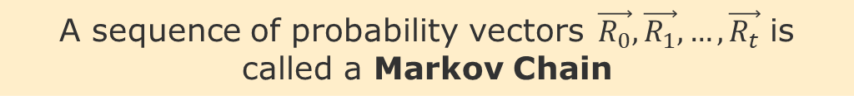
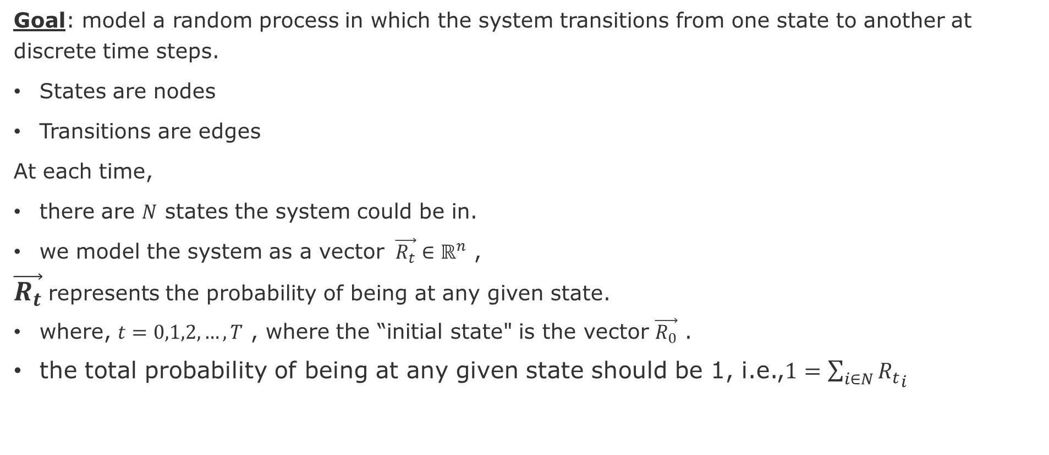
Sampling on Networks = Random Walking
Goal: model a random process in which the system transitions from one state to another at discrete time steps.
States are nodes
Transitions are edges
At each time,
there are $N$ states the system could be in.
we model the system as a vector $\vec{R_{t}}∈ℝ^{n}$ ,
$\vec{R_{t}}$represents the probability of being at any given state.
where, $t=0,1,2, …, T$ , where the “initial state" is the vector $\vec{R_{0}}$ .
the total probability of being at any given state should be 1, i.e.,$1=\sum_{i∈N}{{R_{t}}_{i}}$
A sequence of probability vectors$\vec{R_{0}},\vec{R_{1}},…,\vec{R_{t}}$ is called a Markov Chain

Slide 6
Intro to Discrete Time Markov Chains

Slide 7
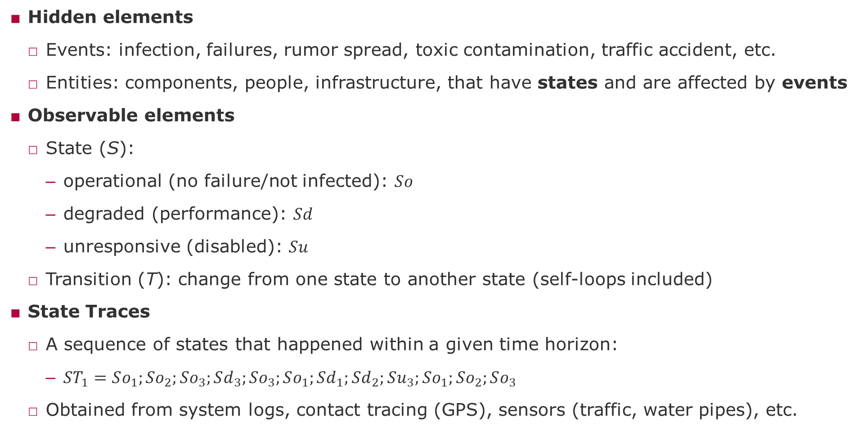
Definitions for the DTMC project
Hidden elements
Events: infection, failures, rumor spread, toxic contamination, traffic accident, etc.
Entities: components, people, infrastructure, that have states and are affected by events
Observable elements
State (S):
operational (no failure/not infected): $So$
degraded (performance): $Sd$
unresponsive (disabled): $Su$
Transition (T): change from one state to another state (self-loops included)
State Traces
A sequence of states that happened within a given time horizon:
$ST_{1}=So_{1};So_{2};So_{3};Sd_{3};So_{3};So_{1};Sd_{1};Sd_{2};Su_{3};So_{1};So_{2};So_{3}$
Obtained from system logs, contact tracing (GPS), sensors (traffic, water pipes), etc.

Slide 8
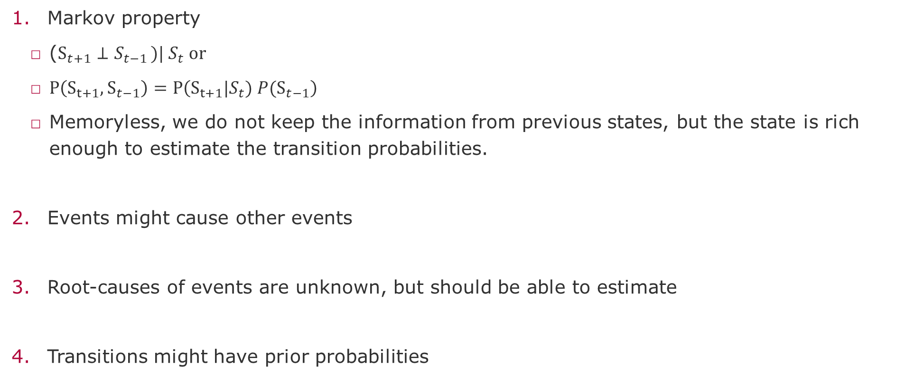
Assumptions
Markov property
($S_{t+1}⊥S_{t−1 })| S_{t} or$
$P\left(S_{t+1},S_{t−1}\right)=P\left(S_{t+1}|S_{t}) P(S_{t−1}\right)$
Memoryless, we do not keep the information from previous states, but the state is rich enough to estimate the transition probabilities.
Events might cause other events
Root-causes of events are unknown, but should be able to estimate
Transitions might have prior probabilities

Slide 9
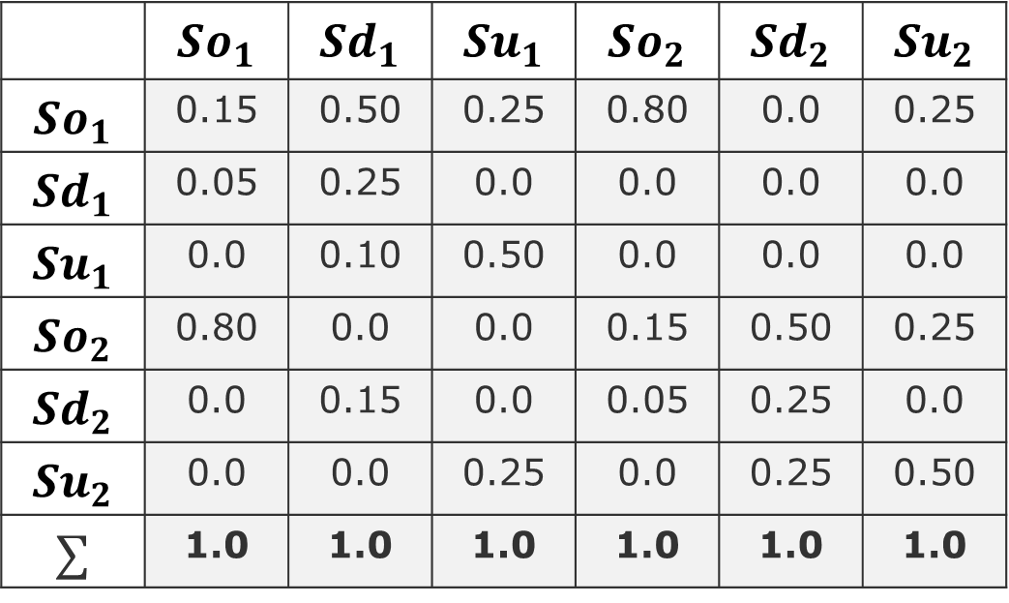
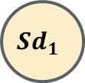
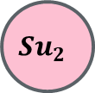

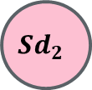
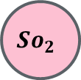

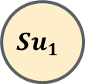
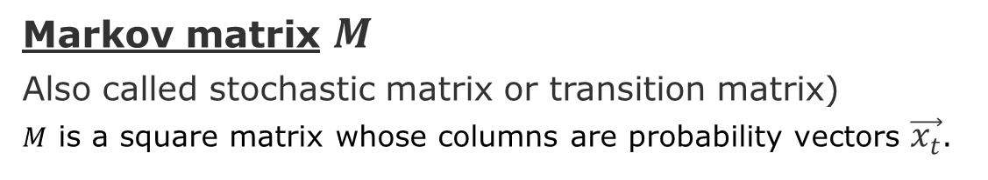
Example of Markov Chain
Markov matrix $M$
Also called stochastic matrix or transition matrix)
$M$ is a square matrix whose columns are probability vectors $\vec{x_{t}}$.
$$So_{1}$$
$$Sd_{1}$$
$$\vec{x_{t}}$$
$$Su_{1}$$
Source states
 | $$So_{1}$$ | $$Sd_{1}$$ | $$Su_{1}$$ | $$So_{2}$$ | $$Sd_{2}$$ | $$Su_{2}$$
$$So_{1}$$ | 0.15 | 0.50 | 0.25 | 0.80 | 0.0 | 0.25
$$Sd_{1}$$ | 0.05 | 0.25 | 0.0 | 0.0 | 0.0 | 0.0
$$Su_{1}$$ | 0.0 | 0.10 | 0.50 | 0.0 | 0.0 | 0.0
$$So_{2}$$ | 0.80 | 0.0 | 0.0 | 0.15 | 0.50 | 0.25
$$Sd_{2}$$ | 0.0 | 0.15 | 0.0 | 0.05 | 0.25 | 0.0
$$Su_{2}$$ | 0.0 | 0.0 | 0.25 | 0.0 | 0.25 | 0.50
$$∑$$ | 1.0 | 1.0 | 1.0 | 1.0 | 1.0 | 1.0
$$Su_{2}$$
$$So_{2}$$
$$Sd_{2}$$
Target states
Intentionally not showing the self-loops

Slide 10

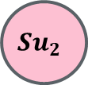


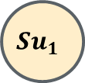
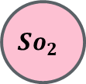
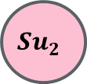
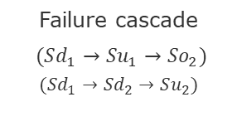
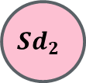

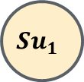

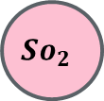


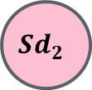
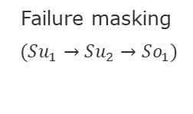
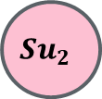

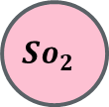
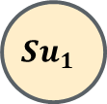
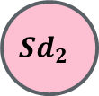
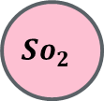
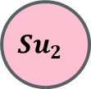
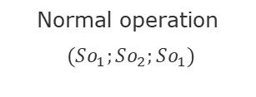


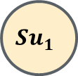






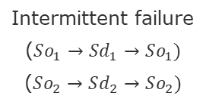
Types of Traces
$$So_{1}$$
$$Sd_{1}$$
$$So_{1}$$
$$Sd_{1}$$
$$So_{1}$$
$$Sd_{1}$$
$$So_{1}$$
$$Sd_{1}$$
$$So_{1}$$
$$Sd_{1}$$
$$Su_{1}$$
$$Su_{1}$$
$$Su_{1}$$
$$Su_{1}$$
$$Su_{1}$$
$$Su_{2}$$
$$Su_{2}$$
$$Su_{2}$$
$$Su_{2}$$
$$Su_{2}$$
$$So_{2}$$
$$Sd_{2}$$
$$So_{2}$$
$$Sd_{2}$$
$$So_{2}$$
$$Sd_{2}$$
$$So_{2}$$
$$Sd_{2}$$
$$So_{2}$$
$$Sd_{2}$$
Normal operation
$(So_{1};So_{2};So_{1})$
Intermittent failure
($So_{1}→Sd_{1}→So_{1})$
($So_{2}→Sd_{2}→So_{2})$
Systemic degradation
($Sd_{1}→Sd_{2})$
Failure masking
$(Su_{1}→Su_{2}→So_{1})$
Failure cascade
$(Sd_{1}→Su_{1}→So_{2})$
$$(Sd_{1}→Sd_{2}→Su_{2})$$

Slide 11
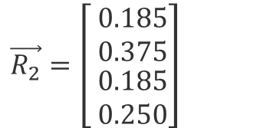
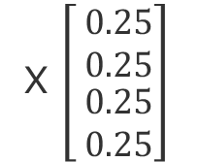

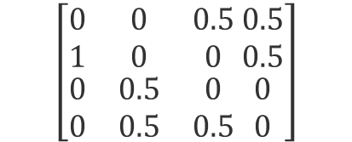
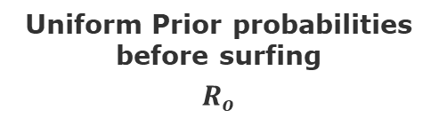
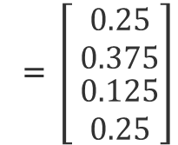

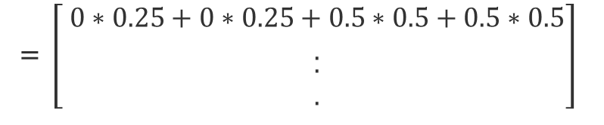
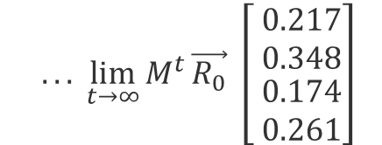
Computation using a Markov Chain
A
B
Transition Matrix $M$
Uniform Prior probabilities before surfing
$$R_{o}$$
Probabilities after iteration 1
0.5
O.5
A
B
C
D
0.5
O.5
0.5
$$\left[\begin{matrix}0 & 0 & 0.5 \\ 1 & 0 & 0 \\ \begin{aligned}0 \\ 0\end{aligned} & \begin{aligned}0.5 \\ 0.5\end{aligned} & \begin{aligned}0 \\ 0.5\end{aligned}\end{matrix} \begin{matrix}0.5 \\ 0.5 \\ \begin{aligned}0 \\ 0\end{aligned}\end{matrix}\right]$$
X $\left[ \begin{matrix}0.25 \\ 0.25 \\ \begin{aligned}0.25 \\ 0.25\end{aligned}\end{matrix}\right]$
= $\left[ \begin{matrix}0.25 \\ 0.375 \\ \begin{aligned}0.125 \\ 0.25\end{aligned}\end{matrix}\right]$
D
C
= $\left[ \begin{matrix}0∗0.25+0∗0.25+0.5∗0.5+0.5∗0.5 \\ . \\ \begin{aligned}. \\ .\end{aligned}\end{matrix}\right]$
O.5
0.5
Next iteration
$\vec{R_{2}}=\left[ \begin{matrix}0.185 \\ 0.375 \\ \begin{aligned}0.185 \\ 0.250\end{aligned}\end{matrix}\right]$
$$... \lim_{t→∞}{M^{t}}\vec{R_{0}} \left[ \begin{matrix}0.217 \\ 0.348 \\ \begin{aligned}0.174 \\ 0.261\end{aligned}\end{matrix}\right]$$
A
B
C
D
Eigenvalues of $M$
A Markov chain has a stationary distribution if and only if the Markov chain is ergodic. If the Markov chain is ergodic, the stationary distribution is unique.

Slide 12
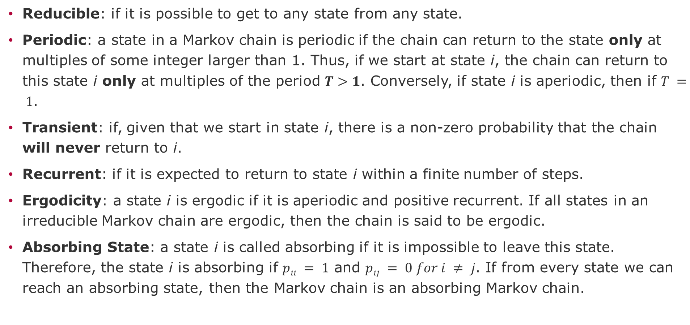
Markov Chain properties
Reducible: if it is possible to get to any state from any state.
Periodic: a state in a Markov chain is periodic if the chain can return to the state only at multiples of some integer larger than 1. Thus, if we start at state i, the chain can return to this state i only at multiples of the period $T>1$. Conversely, if state i is aperiodic, then if $T = 1$.
Transient: if, given that we start in state i, there is a non-zero probability that the chain will never return to i.
Recurrent: if it is expected to return to state i within a finite number of steps.
Ergodicity: a state i is ergodic if it is aperiodic and positive recurrent. If all states in an irreducible Markov chain are ergodic, then the chain is said to be ergodic.
Absorbing State: a state i is called absorbing if it is impossible to leave this state. Therefore, the state i is absorbing if $pii = 1$ and $pij = 0 for i ≠ j$. If from every state we can reach an absorbing state, then the Markov chain is an absorbing Markov chain.
Notes:
Ergodicity (Ludwig Boltzmann) guarantees that starting from a random point, orbits will pass through any other point in space.

Slide 13
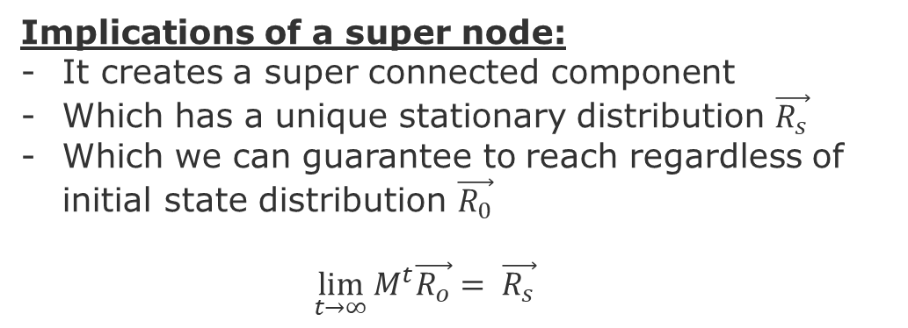
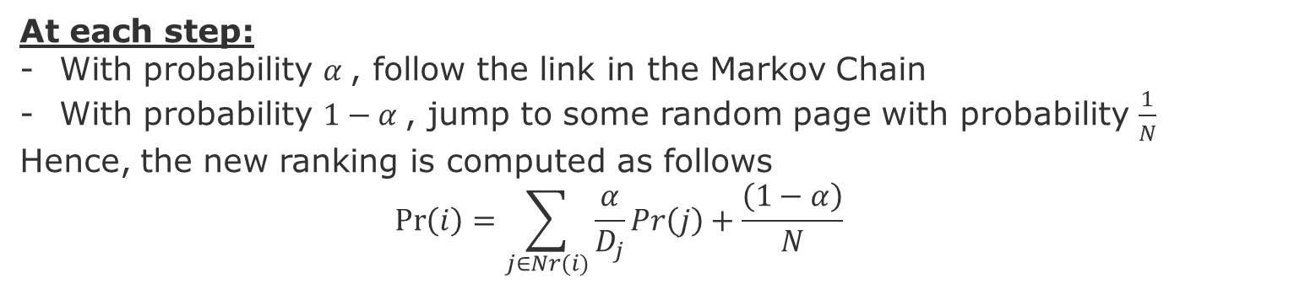
Dead-Ends [Brin, Page, Motwani & Winograd 99]
Super Node
Implications of a super node:
It creates a super connected component
Which has a unique stationary distribution $\vec{R_{s}}$
Which we can guarantee to reach regardless of initial state distribution $\vec{R_{0}}$
$$\lim_{t→∞}{M^{t}\vec{R_{o}}}= \vec{R_{s}}$$
Teleports
Hub
E
H
A
F
Lose, dangling node
(dead-end)
B
G
C
D
Authority
At each step:
With probability $α$, follow the link in the Markov Chain
With probability $1−α$, jump to some random page with probability $\frac{1}{N}$
Hence, the new ranking is computed as follows
$$\operatorname{Pr}\left(i\right)=\sum_{j∈Nr(i)}{\frac{α}{D_{j}}Pr\left(j\right)}+\frac{\left(1−α\right)}{N}$$
Page, L., Brin, S., Motwani, R., & Winograd, T. (1999). The PageRank citation ranking: Bringing order to the web. Stanford InfoLab.

Slide 14
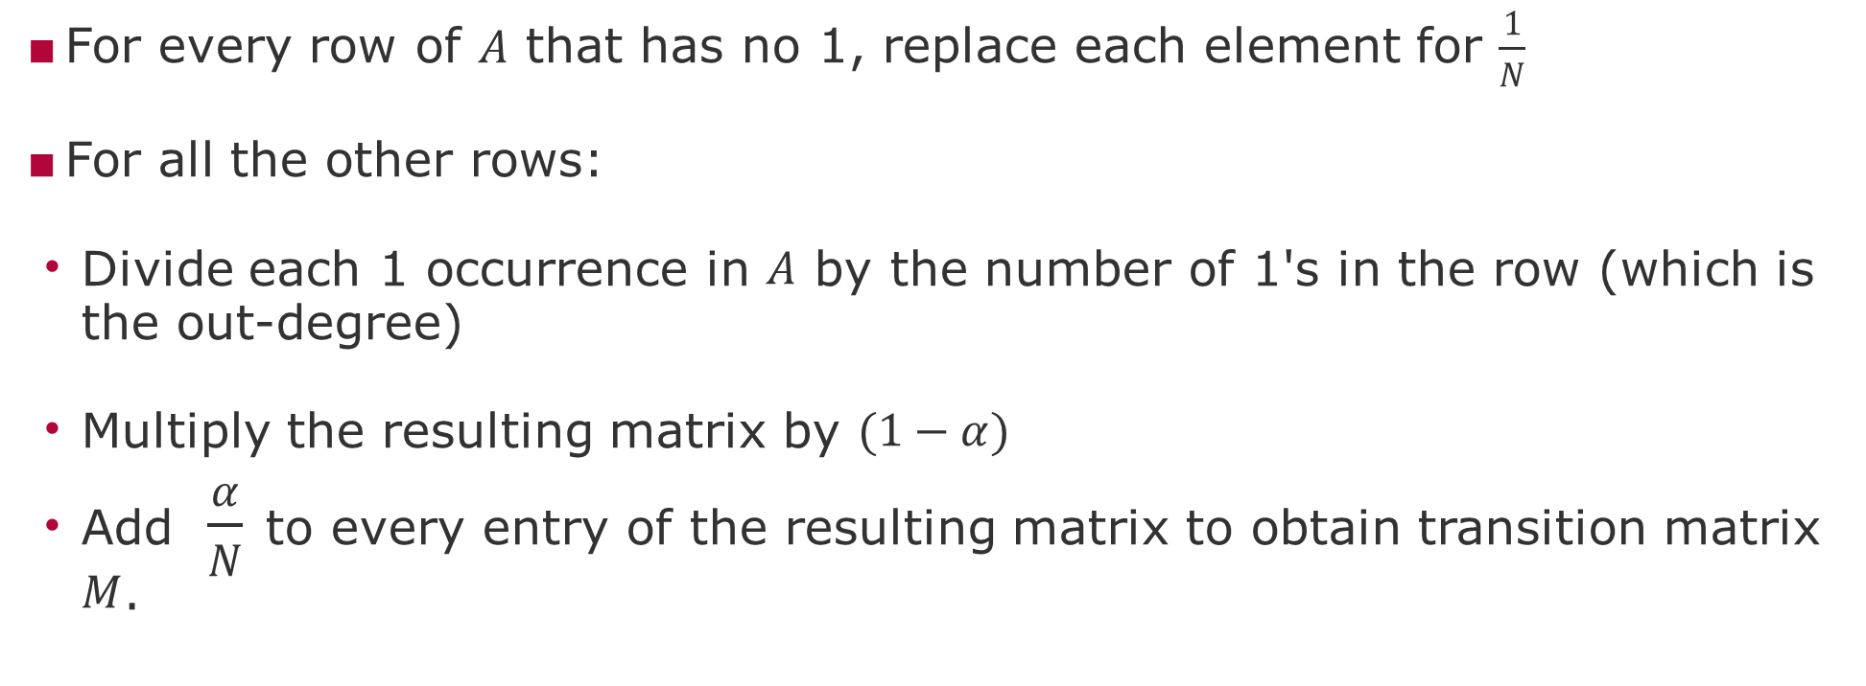
Derivation of Transition matrix $M$ from Adjacency matrix $A$
For every row of $A$ that has no 1, replace each element for $\frac{1}{N}$
For all the other rows:
Divide each 1 occurrence in $A$ by the number of 1's in the row (which is the out-degree)
Multiply the resulting matrix by $(1−α)$
Add $\frac{α}{N}$ to every entry of the resulting matrix to obtain transition matrix $M$.

Slide 15
Next and Future Tasks
Compute and compare graph metrics (Wednesday, 2.12)
Any metrics and networks of your choice
First draft of abstract (Friday, 4.12)
Predictions using traditional method (Wednesday, 9.12)
Any two methods of your choice
Related work draft (Friday, 11.12)
Node and Graph Feature Learning (Wednesday, 16.12)
Any two methods of your choice

Slide 16
Abstract format
[Context] The context explains the domain and the motivation for the research, for instance, a difficulty, cost, risk, or any other impact that people/society/business/environment face.
[Problem] The problem is a general question that if answered would contribute to mitigate or better understand the motivation stated before. In our particular case, problems should framed as prediction and intervention problem, i.e., how to predict an outcome and how to use this prediction to intervene in the process that generates the data. Try to convey three main ideas:
what is the problem?
why is it important?
why is it difficult?
[Investigation approach] The Investigation approach will describe briefly the data (what is it, how it was collected) and the prediction methods (what type of predictions, why are they difficult to produce).

Slide 17
END

